Slide 1
HTML and CSS
Some content from:
Build Your Own Website The Right Way Using HTML & CSS
(Ian Lloyd)
Principles of Web Design (Joel Sklar)

Slide 2
Learning Outcomes
Demonstrate best practices in creating standards-based websites
Learn the basics of the HTML and CSS languages and how they work together
Appreciate some of the history of HTML and the current HTML 5 standard

Slide 3
Remember…
These notes are not meant to be exhaustive or stand-alone
You should read the chapters in the books and watch the videos online – preferably before the lecture – to pick everything up
… and practise making small pages and sites – so it sticks!

Slide 4
Creating Web Pages with HTML
HTML is a markup language (not a programming language) that lets you specify the structure and content of a Web page
Markup elements define each section or item
This <h1> element defines a first-level heading:
<h1>What is HTML?</h1>

Slide 5
Styling Web Pages with CSS
CSS is a style language (also not a programming language) that lets you modify how a Web page appears
The following style rule makes all heading 1 elements blue
h1 {
color: blue;
}

Slide 6
Separation of Form & Function
Content & Structure = HTML
Style = CSS
Dynamic Functionality = JavaScript, PHP…
These should be used appropriately
don't inextricably link content and style.
E.g. make headings headings
Top-level headings must be <h1>, content is structured correctly
Then change the style to make it look like whatever you want
… i.e. if it's too big, don't make it <h2>… that's incorrect

Slide 7
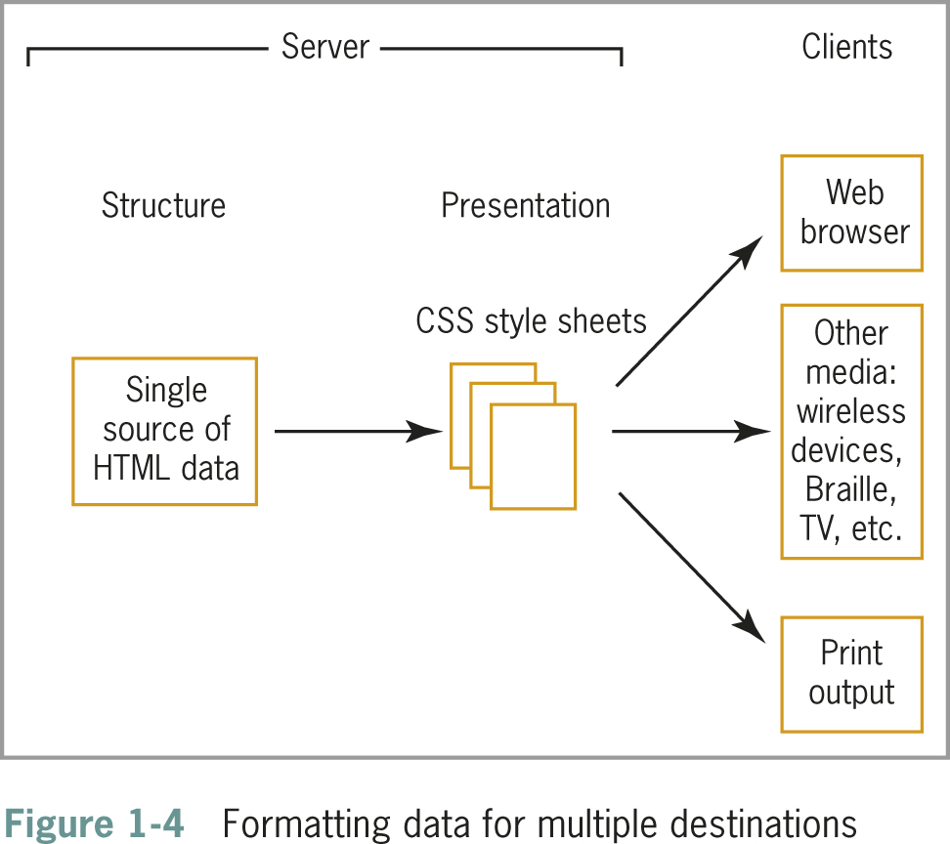
Separation of Form and Function
Form = what it looks like
Style
CSS
Function = what it is
Structure & Content
HTML

Slide 8
Structure of a Basic Web Page
An HTML file contains content text "marked up" with HTML
CSS code can be in the same file or in a separate file
The code itself does not appear in the browser
The browser interprets the HTML & CSS and displays (renders) the results
Each browser interprets HTML & CSS in its own way, based on its rendering engine
It is essential that you test your work in different browsers
different programs and different versions

Slide 9
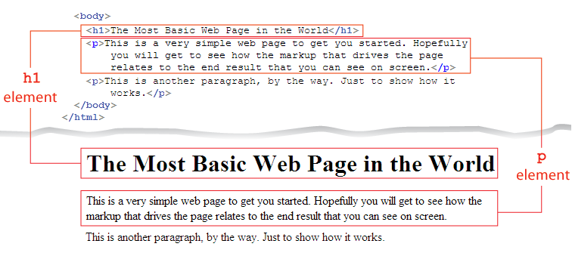

Slide 10
Structure of a Basic Web Page
<!doctype html>
<html>
<head>
<meta charset="UTF-8">
<title>Demonstration Page</title>
</head>
<body>
<h1>Sample Heading</h1>
<p>Simple sample paragragh</p>
</body>
</html>
Notes:
To be drawn on… note: element opening and closing tags

Slide 11
Structure of a Basic Web Page
The document type, or doctype for short, specifies the rules for the document language
The <html> tag is the root element
The two main sections are the <head> and <body> elements
The <head> section is the container for all of the descriptive information about the document (not displayed)
The <body> section includes the content that the user will see in their browser

Slide 12
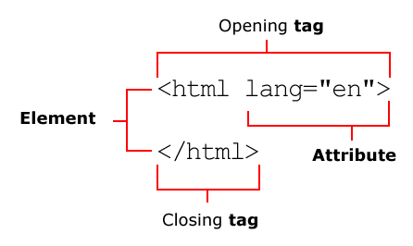
HTML Code
Elements (tags) - the basic building blocks of HTML
Attributes – extra information for elements (properties)
Most elements have opening and closing tags
Some are "void" or "empty": no content or closing tag
(e.g. img, br, hr, meta, input)
Notes:
Add “value” to this – “en” is a value (of an attribute)

Slide 13
HTML Elements
An HTML element starts and ends with tags – the opening tag and the closing tag.
A tag consists of an opening angled bracket (<), some text, and a closing bracket (>). E.g. <p>
Inside a tag, there is a tag name; there may also be one or more attributes with values. E.g. <p class="test">
Non-empty elements have content in them,
should have a closing tag. E.g. <p>Content</p>
Empty elements can not contain content
should not have a closing tag. E.g. <br>
<p class="test">This is a test paragraph.<br>With two lines.</p>

Slide 14
HTML Attributes
HTML elements can have a range of attributes, depending on which element you’re dealing with
Each attribute is made up of a name and a value
Always written as: name="value"
Some are optional, some are compulsory – e.g. the img (image) element requires a source file reference
<img src="photo.jpg" height="100" width="133">

Slide 15
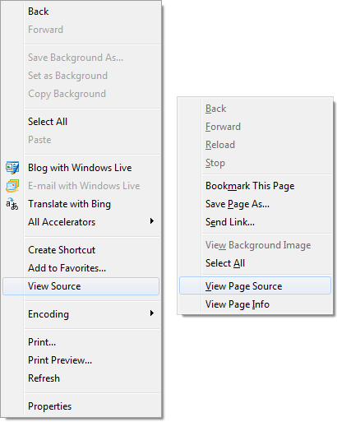
Learn by Example
Since HTML and CSS (and JavaScript but not PHP) are sent to the client, anyone can read the code
Great way to learn
But… Most Web pages don’t use best-practice techniques, so don't trust that everything you see online is good

Slide 16
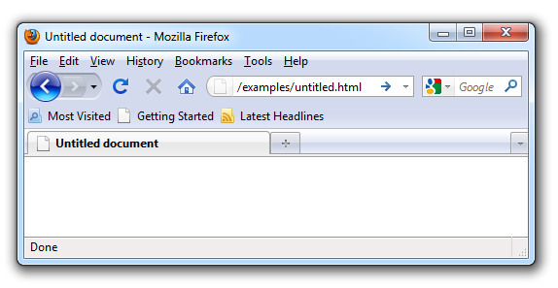
Head section <head>
Not the same as headings <h1> or headers <header>…
Contains information about the page, not information that will be displayed on the page
<title> element – where do you see the title displayed?
Avoid "Untitled document" pages

Slide 17
Body section
<body>
Where everything to display in the browser 'canvas' goes
All content elements (p, div, img, a, head, table, etc.) must be inside the body element

Slide 18

Some HTML Elements (just a selection)
Element | Description
<h1>, <h6> | Heading – the number defines the level; 1 = most important
<ul>, <ol> | Unordered (bulleted) list, ordered (numbered) list
<li> | List item – must be found inside either ul or ol
<a> | Anchor/link – href attribute specifies URL to link to
<img> | Image – src, height, width, alt attributes
<strong> | Strong importance (usually shown as bold)
<em> | Emphasis to enhance meaning (usually shown as italics)
<div> | Division – logical “block-level” section, used to apply styles to
<span> | Span – logical “inline-level” section of content, used to apply styles to
<header>, <footer> | Header, Footer – logical sections (like div) for the header and footer of a section
<script> | Script – used to embed or reference an executable script, usually JavaScript
Learn these and more by practice, not memorisation
https://developer.mozilla.org/en/docs/Web/HTML/Element

Slide 19
Brief History of HTML
Tim Berners-Lee proposed HTML at the European Laboratory for Particle Physics (CERN) in 1989
Berners-Lee joined the ideas of the browser, a markup language (HTML), and a communications protocol that allowed hypertext linking
People could read and create documents easily using HTML
HTML is an application of the Standard Generalized Markup Language (SGML), a standard system for specifying document structure

Slide 20

A Need for Standards
Things got messy in the "bad old days" (mid 90s) with browser-specific HTML and structural elements being used for display information
Using tables for layout and <font> are classic examples
More data-based online applications started being developed (e.g. online banking), which HTML was not suitable for
The World Wide Web Consortium (W3C), founded in 1994 at MIT, sets standards for HTML and other markup languages
Jointly developed standards, rather than ones dictated by one vendor, benefit everyone

Slide 21

A Proposal for HTML5
The Web Hypertext Application Technology Working Group (WHATWG) started HTML5 in 2004 (first public draft 2008)
HTML5:
Supports standards-based coding
Compatible with HTML and XHTML
Compatible with CSS
Supports new page layout elements like <header>, <nav>
Application and media compatible
E.g. video without Flash or other plugins

Slide 22
Working with HTML5
HTML5 attempts to address shortcomings of HTML
Addresses needs of modern Web design
Offers new features:
Logical layout elements
Rich media
Support for applications (e.g. browser-based data storage)
Removes old features:
All display elements removed in favour of CSS
Framesets are gone

Slide 23
Working with HTML5
HTML5 offers two syntax options:
Loose - HTML-compatible syntax
More relaxed syntax
Code shortcuts allowed
e.g. <p class=test>One<p>Two<br>…
Strict - XML-compatible syntax
Consistent with XHTML
Uses XML syntax rules
e.g. <p class="test">One</p><p>Two<br /></p>…

Slide 24
Creating Syntactically Correct Code
(Below are required for any syntax)
Documents must be well-formed
All tags must nest properly and not overlap
(Below are only required for strict syntax)
Use all lowercase for element names
Always use closing tags
Empty elements are marked with a closing slash
Attribute values must be contained in quotation marks

Slide 25
Working with HTML5
We don't require a particular syntax in this subject.
If it validates with W3C validation tools (validator.w3.org), that’s fine.
“Better” code makes pages work better.
You should prefer the sort of code that tools like PHPStorm, Brackets and Dreamweaver make, which is closer to strict.
E.g. always close non-empty elements like <p>
But don’t use closing slashes for empty elements like <br>
Do quote attribute values like <img src="image.png"…

Slide 26
Choosing the Correct doctype
Always use a doctype statement
Using a doctype forces the browser to display in standards mode
Standards mode = browsers try to give documents the specification-wise correct treatment
Quirks mode = browsers violate contemporary Web format specifications in order to avoid “breaking” pages authored according to practices that were prevalent in the late 1990s
The standard doctype statement for HTML5:
<!doctype html>
Notes:
https://hsivonen.fi/doctype/

Slide 27
New Elements in HTML5
HTML5 has a number of new elements
Not all elements are supported by current browsers (most are)
see www.caniuse.com
Test new elements carefully
Many elements have been removed in HTML
mostly those involving presentation effects … why?
Framesets are no longer available

Slide 28
Attributes in HTML5
Elements can contain attributes that set properties
Global attributes can be applied to any element
Including class, id, style (all for CSS), lang, title, accesskey
Earlier versions of HTML had more attributes
HTML5 has fewer attributes because of CSS
E.g. align and border attributes for div elements
http://www.w3.org/TR/html5/obsolete.html

Slide 29
Using HTML5 Elements for Page Structure
Most Web pages contain some common sections:
Header
Navigation
Articles
Figures
Footers
Sidebars
These are commonly marked up with <div> elements and appropriate id or class names
e.g. <div id="header">…</div>

Slide 30
Using HTML5 Elements for Page Structure
The HTML5 elements for page layout include:
<header> Contains the page header content
<nav> Contains the navigation elements for the page
<article> Contains the primary page content
<section> Defines sections or groupings of page content
<aside> Contains additional content such as a quote or sidebar
<figure> Contains images for the article content
<footer> Contains page footer content

Slide 31
Interactive Capabilities in HTML5
Audio and video
new <video> element, video player built in to browser
this means you don't need plugins like Flash Player
Drawing <canvas>
you can use JavaScript to create animations in the canvas
Background application processing
Local data storage

Slide 32
Using Good Coding Practices
Create code that ensures the greatest standards-compliance, presentation, compatibility and usefulness of your content
Stick to the standards
Use semantic markup
Validate your code

Slide 33
Stick to the Standards
Stick to the W3C standards
Separate content from presentation
Plan for your sites to be accessible to different devices
Standardised coding and design is more accessible

Slide 34
Use Semantic Markup
Semantic markup identifies the intended use of document sections (what it is)
Accurately describes each piece of content
Until recently, this logical (correct) use of HTML elements was often ignored
Document elements must match the meaning and usage of the document sections:
<p> for paragraph, <h1> for first-level heading, and so on
<h2> isn't just a smaller heading, it's a second-level heading (imagine book chapters, sections, sub-sections…)

Slide 35
Validate Your Code
Valid code conforms to the usage rules of the W3C
Valid code enhances browser compatibility, accessibility, and exchange of data
The most common mistakes include:
No doctype declaration
Missing closing tags
Missing required attributes like alt in <img> elements
Incorrect tag nesting
Unquoted attributes
Notes:
http://validator.w3.org/docs/why.html

Slide 36
Exam Questions
What are the (loose) syntax errors in the following code?
<a href=testq.html id="test">Link</a>
<p>I am <em>very <strong>happy</em></strong> now</p>
My favourites: <li>James</li> and <li>Paul</li>
<center border="1">Here’s more</center>
<h1>Most important</h1><h4>Not so important<p>Normal
Answer:
https://validator.w3.org/check?uri=http%3A%2F%2Fditwebtsv.jcu.edu.au%2F%7Esci-lmw1%2Ftest.html&charset=%28detect+automatically%29&doctype=Inline&group=0

Slide 37
CSS
Cascading Style Sheets

Slide 38
Adding Style with CSS
Web designers use Cascading Style Sheets (CSS) to add presentation information to Web pages
CSS lets you control the presentation characteristics of an entire website (multiple pages) with a single style sheet
Can also have multiple sheets for different devices
Presentation properties are separate from the content

Slide 39
The Development of CSS
CSS was developed to standardise display information
HTML = what it is
CSS = what it looks like
CSS was slow to be supported by browsers
Newer browsers offer more complete support
Latest release is CSS3

Slide 40
CSS Style Rules
Style rules express the style characteristics for an HTML element
It's important to note that style rules apply to HTML elements.
If you want to apply them to something else, you need to make that into an element (e.g. with div or span).
A set of style rules is called a style sheet
usually a separate file with .css extension

Slide 41
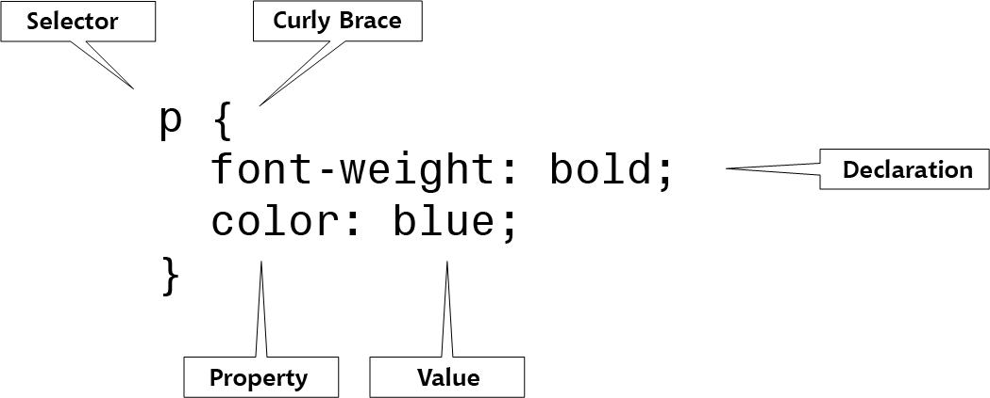
CSS Style Rules
Rules are composed of: a selector and a declaration
The selector specifies the element to which the rule is applied
The declaration specifies the exact property and values

Slide 42
Combining CSS Style Rules with HTML
You can combine CSS with HTML in three ways:
Inline style - applies only to this element
Internal style sheet - applies to whole page
External style sheet - applies to multiple pages
Notes:
"multiple pages" = wherever it's specified

Slide 43
Using External Style Sheets
External style sheets let you specify rules for multiple pages
These are just text documents with .css extension that contain style rules
This is the preferred method in most cases
<head>
...
<link href="styles.css" rel="stylesheet" type="text/css">
</head>

Slide 44
Using Internal Style Sheets
Contained within the <style> element, which is contained within the <head> section
Only affect the document in which they reside
<head>
...
<style type="text/css">
h1 {color: red;}
</style>
</head>

Slide 45
Using Inline Styles
You can define styles for a single element with the style attribute
The style HTML attribute can be used to override a style that was set at a higher level
The style attribute is useful for testing styles during development, or to specify a property that will only ever apply in one situation (unlikely)
<h1 style="color: blue">Some Text</h1>

Slide 46
Understanding The Cascade
"Cascading" means that multiple style sheets and style rules can apply to the same document/element
Only one rule can apply to an element for a given property
Any number of rules can apply for different properties
The CSS cascading mechanism determines which rules apply based on three variables:
Specificity of the selector
Order of the rule in the style sheet
Use of the !important keyword

Slide 47
Using Inheritance to Simplify Styles
Elements in an HTML document are structured in a hierarchy
Parent elements contain child elements
e.g. <li> will be a child of <ul> or <ol>
Elements can be both parent and child elements
The CSS properties inherit from parent to child
E.g. if you make the <ul> blue, the <li> in it will also be blue
You can style multiple document elements with just a few style rules using inheritance

Slide 48
Using Inheritance to Simplify Styles
Individual style rules:
h1 {color: red;}
p {color: red;}
ul {color: red;}
em {color: red;}
li {color: red;}
Or using inheritance:
body {color: red;}
body is the most useful/common element (selector) to set your default page styles like background colour and font – inherited by everything else

Slide 49
Using Type Selectors
The selector determines the element to which a style declaration is applied
Type selectors are the simplest form of selector
They select every instance of that element in the document
In the following example, all h1 elements will be red
h1 {color: red;}

Slide 50
Grouping Selectors
You can group selectors to which the same rules apply
Specific style rules:
h1 {color: red;}
h2 {color: red;}
Grouping selectors (note the comma):
h1, h2 {color: red;}

Slide 51
Combining Declarations
You can state multiple property declarations for the same selector
Individual style rules:
p {color: blue;}
p {font-size: 125%;}
Combining declarations:
p {
color: blue;
font-size: 125%;
}
There is no real standard for CSS formatting (e.g. indenting). Using what Dreamweaver makes is a good idea.

Slide 52
Using Descendant Selectors
You can select elements that are descendents of other elements
Selecting only <em> elements that are contained somewhere within <p> elements (note the space):
p em {color: blue;}
<p>Default <em>this selected</em></p>
<em>this not selected</em>
<p><div><em>is selected</em></div></p>
In the last line, the <em> is a descendant ("grandchild") of the <p>, but not a child. It is selected by the descendant selector.

Slide 53
Using Child Selectors
You can select elements that are direct children of other elements
Selecting only <em> elements that are contained directly within <p> elements (note the >):
p > em {color: blue;}
<p>Default <em>this selected</em></p>
<em>this not selected</em>
<p><div><em>this not selected</em></div></p>
In the last line, the <em> is a descendant ("grandchild") of the <p>, but not a child. It is not selected by the child selector.

Slide 54
Using the Universal Selector
Universal selector lets you select groups of elements
Selecting all children of any div elements:
div * {color: blue;}
<div>...<em>this selected</em></div>
<div>this not selected</div>
What would * div select?
Notes:
* div would select divs that are descendants of anything… which should be all of them, since they would all be inside body at least.

Slide 55
Using the Class Selector
The class selector lets you write rules and give them a name
Use logical names like warning, not style-based names like redText (which might become less meaningful if styles change)
You can apply that name to any element you choose using the HTML class attribute
The dot (.) flag character indicates the selector is a class selector
E.g.
.warning { color: red }
Applied using:
<p class="warning">… or <h1 class="warning">…

Slide 56
Using the Class Selector
CSS style rule:
.intro {font-size: 125%;}
Used in HTML:
<p class="intro">This is the first paragraph of the document.</p>

Slide 57
Using the id Attribute Selector
id is just like class, except:
id refers to a unique (only one) instance of the id attribute value within a document
multiple instances of the same id is invalid
id uses a hash (#) flag character instead of period (.)
The id attribute should be used to identify parts of the page that only occur once, e.g. logo, copyright…
class is used for repeatable sections/styles, e.g. pullquote, highlight, errormessage…
Notes:
# is not a "hash tag" in this context

Slide 58
Using the id Attribute Selector
CSS style rule:
#copyright { color: white; }
Used in HTML:
<p id="copyright">copyright info.</p>

Slide 59
Using the <div> and <span> Elements
The <div> (division) and <span> (span) elements are designed to be used with CSS
They let you specify logical sections within a document that have their own name and style properties
div is used to divide up a web page – to provide a definite structure that can be combined with CSS to great effect
It adds a break before and after the contained text
it is a block-level element

Slide 60
Working with <div> elements
Use <div> with the class or id attributes to create logical, block divisions on a Web page
CSS style rule:
#column {
width: 200px;
height: auto;
padding: 15px;
border: thin solid;
}
Used in HTML:
<div id="column">This division is styled</div>
Could also use:
div#column as the selector
(What's the difference?)

Slide 61
Working with <span> Elements
The span element lets you specify inline elements that have their own name and style properties
In-line elements reside within a line (of text)
div = block - adds line break before and after
span = inline - no breaks, can't contain block elements
<span style="display:block"> is identical to div :)

Slide 62
Working with Span Elements
CSS style rule:
. {
color: white;
background-color: black;
}
Used in HTML:
<p>A <span class="inverse">Wonderful</span>site.</p>
Could also use:
span.inverse as the selector
Would only apply to spans with the inverse class

Slide 63
Soooo much more…
Make sure you're reading and watching the book and video resources
Take notes
and… practise!

Slide 64
1. Exam-style Question (Precedence)
What colour will the text "here" be?
body {color: blue;}
.one {color: green;}
p {color: red;}
<body><p class="one">here</p></body>

Slide 65
2. Exam-style Question (Precedence)
What colour will the text "here" be?
body {color: blue;}
.one {color: green;}
p {color: red;}
<body><p class="body">here</p></body>

Slide 66
Summary
Use best practices in creating standards-based websites
HTML and CSS are the core languages used to make websites
HTML is used for content and structure markup (function)
CSS is used for presentation (form)
Follow the standards in how you use these

